Slide 1
Distal Humerus Fractures (adults)
Dr. Nyakure

Slide 2
Anatomy
Elbow is a hinged joint
Trochlea
articulates with sigmoid notch
allows for flexion and extension
Capitellum
articulates with proximal radius
allows for forearm pronation and supination

Slide 3
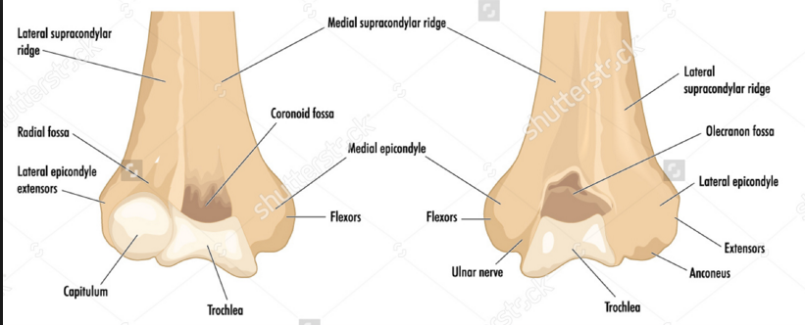
Anatomy

Slide 4
Epidemiology
incidence
distal intercondylar fractures are the most common fracture pattern
most common in young males and older females
mechanism
low energy falls in elderly
high energy impact in younger population

Slide 5
Pathoanatomy
elbow position affects fracture type
elbow flexed < 90 degrees
axial load leads to transcolumnar fracture
direct posterior blow leads to olecranon fracture with or without distal humerus involvement
elbow flexed > 90 degrees
may lead to intercondylar fracture

Slide 6
Associated injuries
elbow dislocation
terrible triad injury
floating elbow
Volkmann contracture
result of a missed forearm compartment syndrome

Slide 7
Prognosis
Majority of patients regain 75% of elbow motion and strength
Goal is to restore elbow ROM 30-130 degrees of flexion
Unsatisfactory outcomes in up to 25%

Slide 8
Classification
Supracondylar fractures
Single column fractures
lateral condyle more common than medial
Bicolumnar fractures
5 major articular fragments have been identified
capitellum/lateral trochlea
lateral epicondyle
posterolateral epicondyle
posterior trochlea
medial trochlea/epicondyle
Coronal shear fractures

Slide 9
AO classification
AO/OTA Classification of Distal Humerus Fractures
Type A | Extraarticular (supracondylar fracture) 80% are extension type
Type B | Intraarticular-Single column (partial articular-isolated condylar, coronal shear, epicondyle)
Type C | Intraarticular-Both columns fractured and no portion of the joint contiguous with the shaft (complete articular)

Slide 10
Jupiter classification
Jupiter Classification of Two-Column Distal Humerus Fractures
High-T | Transverse fx proximal to or at upper olecranon fossa
Low-T | Transverse fx just proximal to trochlea (common)
Y | Oblique fx line through both columns with distal vertical fx line
H | Trochlea is a free fragment (risk of AVN)
Medial lambda | Proximal fx line exists medially
Lateral lambda | Proximal fx line exists laterally

Slide 11
Clinical findings
Symptoms
elbow pain and swelling
Physical exam
gross instability often present
avoid ROM due to risk of neurovascular damage
neurovascular exam
check function of radial, ulnar, and median nerve
check distal pulses
brachial artery may be injured
if pulse decreased, obtain noninvasive vascular studies; consult vascular surgery if abnormal
monitor carefully for forearm compartment syndrome

Slide 12
Imaging
Radiographs
recommended views
AP and lateral of humerus and elbow
include entire length of humerus and forearm
additional views
wrist radiographs if elbow injury present or distal tenderness on exam
oblique radiographs may assist in surgical planning
traction radiographs may assist in surgical planning
evaluate continuity of the trochlear fragment to medial epicondylar fragment, this can influence hardware choice
CT
often obtained for surgical planning
when shear fractures of the capitellum and trochlea are suspected
3D CT scan improves the intraobserver and interobserver reliability of several classification systems
MRI
usually not indicated in acute injury

Slide 13
treatment
Nonoperative
cast immobilization
indications
nondisplaced Milch Type I fractures
technique
immobilize in supination for lateral condyle fractures
immobilize in pronation for medial condyle fractures
Operative
closed reduction and percutaneous pinning
Unicondylar fractures
open reduction internal fixation
indications
supracondylar fractures
Milch Type II fractures
total elbow arthroplasty
indications
distal bicolumnar fractures in elderly patients

Slide 14
Complications
Ulnar nerve injury
Elbow stiffness
most common
Heterotopic ossification
reported rate of 8%
routine prophylaxis is not warranted
increased rate of nonunion in patients treated with indomethacin
Nonunion
low incidence
avoid excessive soft-tissue stripping
Malunion
avoided by proper surgical technique
cubitus valgus (lateral column fractures)
cubitus varus (medial column fractures)
Degenerative Joint Disease

